Slide 1
Design Patterns with java

Slide 2
What are Design Patterns?
Design patterns are optimized, reusable solutions to the programming problems
A design pattern is not a class or a library that we can simply plug into our system
It is a template that has to be implemented in the correct situation
It’s not language-specific either
A good design pattern should be implementable in most of the languages, depending on the capabilities of the language

Slide 3
What are Design Patterns?
Most importantly, any design pattern can be a double-edged sword
If implemented in the wrong place, it can be disastrous and create many problems
However, implemented in the right place, at the right time, it can be a boon
Design Pattern are proven solutions approaches to specific problems

Slide 4
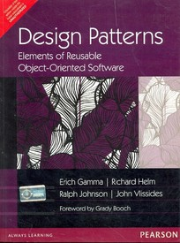
Gang of Four
The Gang of Four (GOF or GO4) are the authors of the book, Design Patterns: Elements of Reusable Object-Oriented Software
This book describes various development techniques and pitfalls in addition to providing twenty-three O O programming design patterns
The book's authors are
Erich Gamma
Richard Helm
Ralph Johnson
John Vlissides

Slide 5
Usage of Design Patterns
Common language for developers:
They provide developer a common language for certain problems. For example if a developer tells another developer that he is using a Singleton, the another developer (should) know exactly what this means
Capture best practices:
Design patterns capture solutions which have been applied to certain problems. By learning these patterns and the problem they are trying to solve a un-experienced developer can learn a lot about software design.

Slide 6
Quick Review of Java (OOP)
Classes and Objects
Class Structure
Communication between objects
Why object creation is dynamic
Inheritance (IS-A relationship)
Polymorphism
Composition (HAS-A relationship)
Inheritance VS Composition
Difference between abstract class and interface
Interface based application design
Multi layer applications

Slide 7
Types of design Patterns
There are three basic types of design patterns:
Creational
Structural
Behavioral
Creational patterns provide ways to instantiate single objects or groups of related objects.
Structural patterns provide manner to define relationships between objects, making it easier for these entities to work together
Behavioral patterns define the way of communication between objects

Slide 8
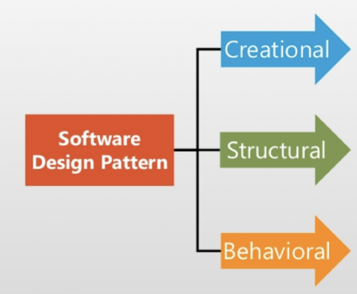
Types of design Patterns
to create objects in a controlled manner suitable to the situation
to assemble objects and classes into larger structures while keeping these structures flexible and efficient
to ensure effective communication between components

Slide 9
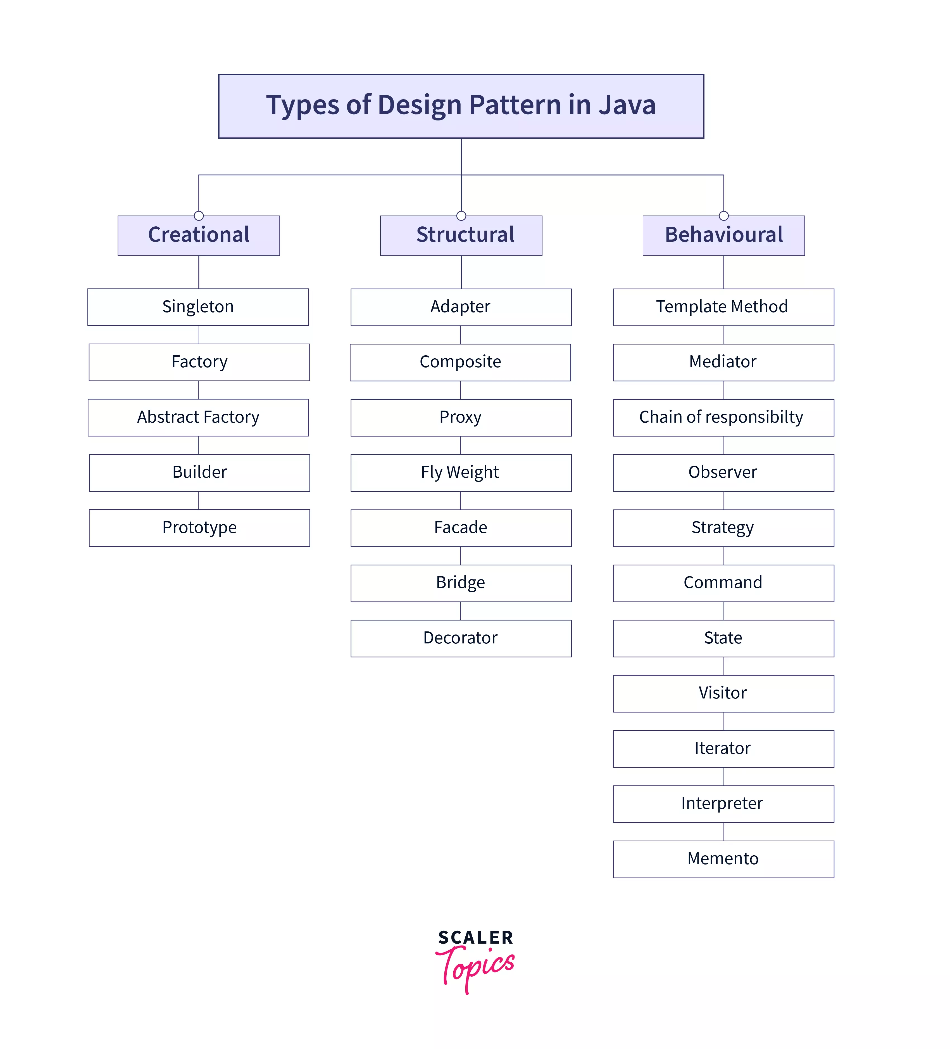
Types of design Patterns

Slide 10
Creational Patterns

Slide 11
Creational Patterns
Creational patterns prescribe the way the objects are created
These patterns are used when a decision must be made at the time a class is instantiated
The details of the classes that are instantiated ( what exactly they are, how, and when they are created ) are hidden from the client class
Client class knows only about the abstract class or the interface it implements
The specific type of the concrete class is unknown to the client class

Slide 12
Creational Patterns
Creational Design Patterns
Singleton Pattern
Factory Pattern
Abstract Factory Pattern
Prototype Pattern
Builder Pattern

Slide 13
Singleton Pattern
A singleton in is a class for which only one instance can be created and provides a global point of access this instance
The singleton pattern describe how this can be archived
Singletons are useful to provide a unique source of data or functionality to other Java Objects
For example, you may use a singleton to access your data model from within your application or to define logger which the rest of the application can use

Slide 14
Singleton Pattern
A singleton is a class that is instantiated only once
This is accomplished by creating a static field in the class representing the class
A static method exists on the class to obtain the instance of the class and is named such as getInstance()
The creation of the object referenced by the static field can be done either when the class is initialized or the first time that getInstance() is called
The singleton class typically has a private constructor to prevent from being instantiated via a constructor
The instance of the singleton is obtained via the static getInstance() method.

Slide 15
Singleton Pattern
Define a private static attribute in the "single instance" class.
Define a public static accessor function in the class.
Do "lazy initialization" (creation on first use) in the accessor function.
Define all constructors to be protected or private.
Clients may only use the accessor function to manipulate the Singleton.

Slide 16
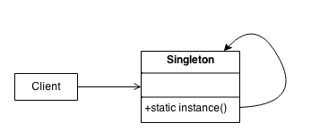
Singleton Pattern

Slide 17
Singleton Pattern
Drawbacks
This pattern reduces the potential for parallelism within a program, because access to the singleton in a multi-threaded context must be synchronized
Advocates of dependency injection would regard this as an anti-pattern, mainly due to its use of private and static methods

Slide 18
Factory Pattern
The factory pattern (factory method pattern) is a creational design pattern
A factory is a class that is used to encapsulate object creation code
A factory class instantiates and returns a particular type of object based on data passed to the factory
The different types of objects that are returned from a factory typically are subclasses of a common parent class
The creational method is often called something such as getInstance
The factory pattern is used to replace class constructors, abstracting the process of object generation so that the type of the object instantiated can be determined at run-time

Slide 19
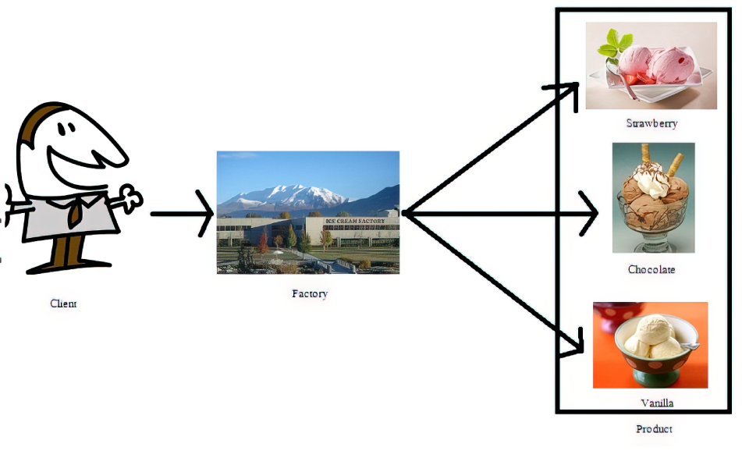
Factory Pattern

Slide 20
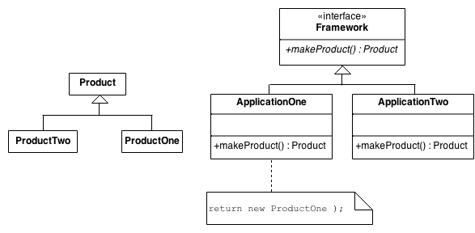
Factory Pattern

Slide 21
Factory Pattern
A good example is when creating a connection to a data source if the type of the data source will be selected by the end-user
In this case, an abstract class named "DataSource" may be created that defines the base functionality of all data sources
Many concrete subclasses may be created, perhaps "SqlDataSource", “XmlDataSource", "CsvDataSource", etc, each with specific functionality for a different type of data
At run-time, a factory class, perhaps named "DataSourceFactory", generates objects of the correct concrete class based upon a parameter passed to the factory method

Slide 22
Factory Pattern
It is common to pass data that determines the type of object to be created to the factory when the factory is created (using constructor)
However, if multiple objects are being created by the factory, it may make sense to pass this data to the factory's creational method, since it might not make sense to create a new factory object each time we wanted to have the factory instantiate a new object.
A factory may also be used in conjunction with the singleton pattern. It is common to have a singleton return a factory instance
Replace
with
AnimalFactory animalFactory = new AnimalFactory();
AnimalFactory animalFactory = AnimalFactory.getAnimalFactoryInstance();

Slide 23
Factory Pattern check list
If you have an inheritance hierarchy that exercises polymorphism, consider adding a polymorphic creation capability by defining a static factory method in the base class
Design the arguments to the factory method based on qualities or characteristics to identify the correct derived class to instantiate
Consider designing an internal "object pool" that will allow objects to be reused instead of created from scratch
Consider making all constructors private or protected

Slide 24
Prototype Pattern
In the prototype pattern, a new object is created by cloning an existing object.
In Java, the clone() method is an implementation of this design pattern.
One example of how this can be useful is - if an original object is created with a resource such as a data stream that may not be available at the time that a clone of the object is needed
Another example is - if the original object creation involves a significant time commitment, such as reading data from a database.
Normally in Java, if you'd like to use cloning (ie, the prototype pattern), you can utilize the clone() method and the Cloneable interface.
By default, clone() performs a shallow copy

Slide 25
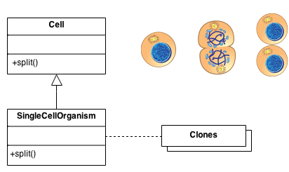
Prototype Pattern

Slide 26
Structural Patterns

Slide 27
Structural Patterns
Structural patterns provide a manner to define relationships between classes or objects
They use inheritance to compose interfaces and define ways to compose objects to obtain new functionality.

Slide 28
Structural Patterns
Adapter Pattern
Composite Pattern
Proxy Pattern
Facade Pattern
Flyweight Pattern
Bridge Pattern
Decorator Pattern

Slide 29
Adapter Pattern
In the adapter pattern, a wrapper class (ie, the adapter) is used translate requests from it to another class (ie, the adaptee).
In effect, an adapter provides particular interactions with an adaptee that are not offered directly by the adaptee
The adapter pattern takes two forms.
In the first form, a "class adapter" utilizes inheritance.
The class adapter extends the adaptee class and adds the desired methods to the adapter
In the second form, an "object adapter" utilizes composition. The object adapter contains an adaptee and implements the target interface to interact with the adaptee.

Slide 30
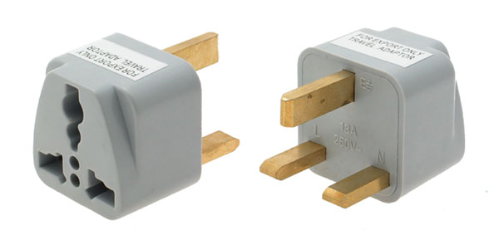
Adapter Pattern

Slide 31
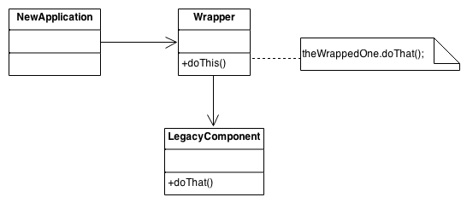
Adapter Pattern

Slide 32
Proxy Pattern
In the proxy pattern, a proxy class object is used to control access to another class object.
The reasons for this control can vary. As one example, a proxy may avoid instantiation of an object until the object is needed.
This can be useful if the object requires a lot of time or resources to create.
Another reason to use a proxy is to control access rights to an object.
A client request may require certain credentials in order to access the object.

Slide 33
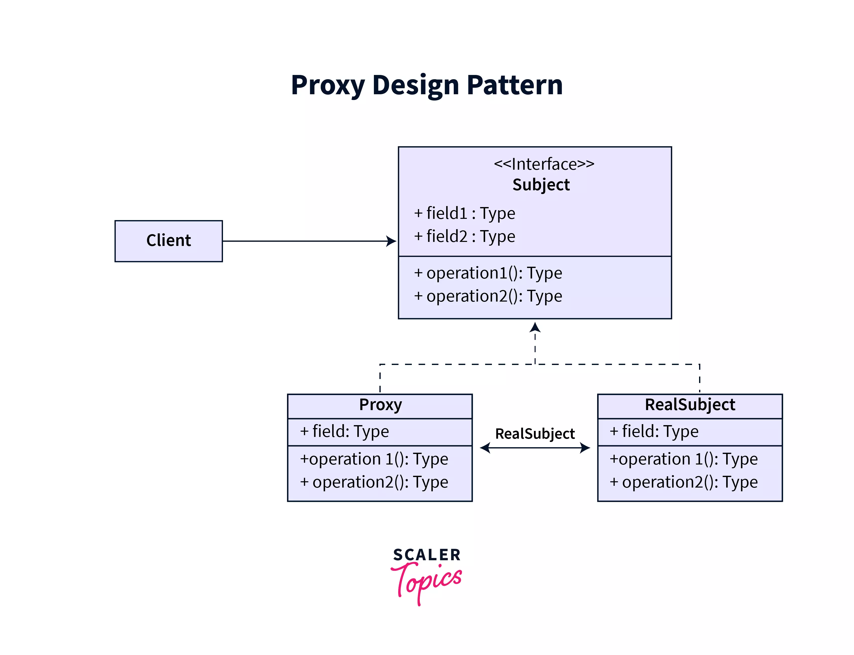
Proxy Pattern

Slide 34
Proxy Pattern
Create Subject interface which is used by the client.
It is the common interface for RealSubject and Proxy so that a Proxy can be used anywhere a RealSubject is expected.
It defines the operations that are to be expected by the actual implementations.
Real Subject provides the real implementation of the operations defined in the Subject Interface
Proxy subject implements the Subject Interface to disguise itself as a Real Subject's object.
It also maintains a reference to the RealSubject to provide actual functionality.
It controls access to the RealSubject and may be responsible for its creation and deletion

Slide 35
Proxy Pattern
common use cases in which the Proxy pattern
A virtual proxy is a placeholder for "expensive to create" objects. The real object is only created when a client first requests/accesses the object
A remote proxy provides a local representative for an object that resides in a different address space (stub in RMI)
A protective proxy controls access to a sensitive master object. The "surrogate" object checks that the caller has the access permissions required prior to forwarding the request
A cache proxy that can preserve some values returned by the object earlier

Slide 36
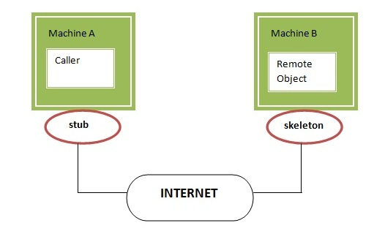
Proxy Pattern in RMI

Slide 37
Facade Pattern
facade class is used to provide a single interface to set of classes.
The facade simplifies a clients interaction with a complex system by localizing the interactions into a single interface.
As a result, the client can interact with a single object rather than being required to interact directly in complicated ways with the objects that make up the subsystem

Slide 38
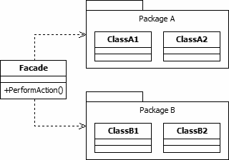
Facade Pattern

Slide 39
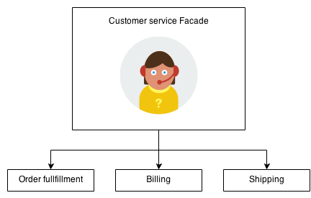
Facade Pattern

Slide 40
Behavioral Patterns

Slide 41
Behavioral Patterns
Behavioral patterns are used in communications between entities
They make it easier and more flexible for these entities to communicate

Slide 42
Behavioral Patterns
Strategy Pattern
Chain of Responsibility Pattern
Observer Pattern
State Pattern
Command Pattern
Iterator Pattern
Interpreter Pattern
Template Method Pattern
Mediator Pattern
Visitor Pattern
Memento Pattern

Slide 43
Strategy Pattern
This pattern enables an object to choose from multiple algorithms and behaviors at runtime, rather than statically choosing a single one.
It is based on the principle of composition over inheritance.
It defines a family of algorithms, encapsulates each one, and makes them interchangeable at runtime.
The core idea behind this pattern is to separate the algorithms from the main object
This allows the object to delegate the algorithm's behavior to one of its contained strategies

Slide 44
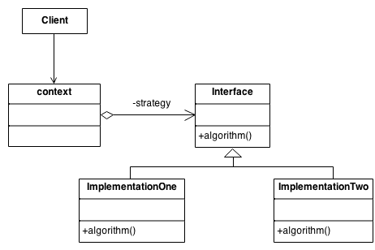
Strategy Pattern

Slide 45
Strategy VS Inheritance
The strategy pattern is one way that composition can be used as an alternative to subclassing.
Rather than providing different behaviors via subclasses overriding methods in super classes, the strategy pattern allows different behaviors to be placed in Concrete Strategy classes which share the common Strategy interface
In simpler terms, the Strategy Design Pattern provides a way to extract the behavior of an object into separate classes that can be swapped in and out at runtime

Slide 46
Inheritance Solution
public class Animal {
public void sound() {
System.out.println("Animal makes a sound");
}
}
public class Dog extends Animal {
public void sound() {
System.out.println("Dog barks");
}
}
public class Cat extends Animal {
public void sound() {
System.out.println("Cat meows");
}
}
3 fundamental questions
What if Animal has additional methods
What happens when new methods added to Animal
What if you want multiple inheritance

Slide 47
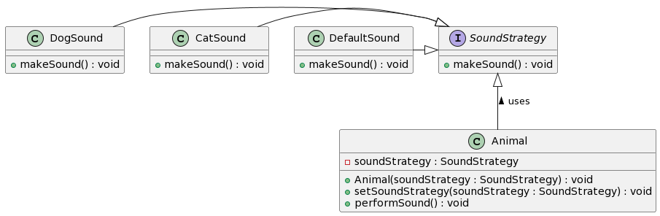
Strategy Solution

Slide 48
Strategy Solution
public interface SoundStrategy {
void makeSound();
}
public class DogSound implements SoundStrategy {
@Override
public void makeSound() {
System.out.println("Dog barks");
}
}
public class CatSound implements SoundStrategy {
@Override
public void makeSound() {
System.out.println("Cat meows");
}
}
public class Animal {
private SoundStrategy soundStrategy;
public Animal(SoundStrategy soundStrategy) {
this.soundStrategy = soundStrategy;
}
public void setSoundStrategy(SoundStrategy soundStrategy) {
this.soundStrategy = soundStrategy;
}
public void performSound() {
soundStrategy.makeSound();
}
}
separate Dog and Cat classes are no longer necessary

Slide 49
Chain of Responsibility Pattern
a series of handler objects are chained together to handle a request made by a client object.
If the first handler can't handle the request, the request is forwarded to the next handler, and it is passed down the chain until the request reaches a handler that can handle the request or the chain ends.
In this pattern, the client is decoupled from the actual handling of the request, since it does not know what class will actually handle the request
Handler is an interface for handling a request and accessing a handler's successor.
A Handler is implemented by a Concrete Handler. The Concrete Handler will handle the request or pass it on to the next Concrete Handler.
A Client makes the request to the start of the handler chain

Slide 50
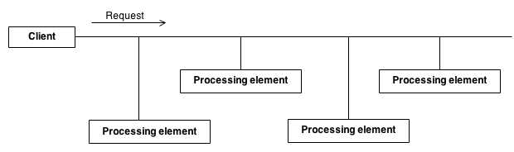
Chain of Responsibility Pattern

Slide 51
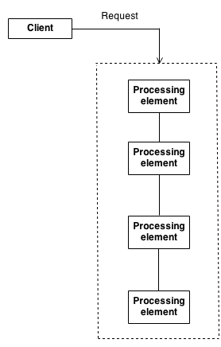
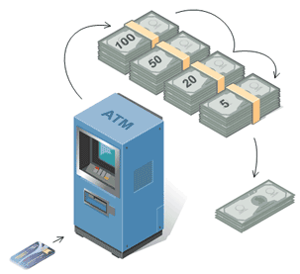
Chain of Responsibility Pattern
Encapsulate the processing elements inside a "pipeline" abstraction; and have clients "launch and leave" their requests at the entrance to the pipeline
2140

Slide 52
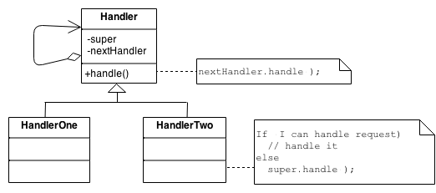
Chain of Responsibility Pattern
The derived classes know how to satisfy Client requests. If the "current" object is not available or sufficient, then it delegates to the base class, which delegates to the "next" object, and the circle of life continues

Slide 53
Observer Pattern
Define an object that is the "keeper" of the data model and/or business logic (the Subject).
Delegate all "view" functionality to decoupled and distinct Observer objects.
Observers register themselves with the Subject as they are created.
Whenever the Subject changes, it broadcasts to all registered Observers that it has changed, and each Observer queries the Subject for that subset of the Subject's state that it is responsible for monitoring.

Slide 54
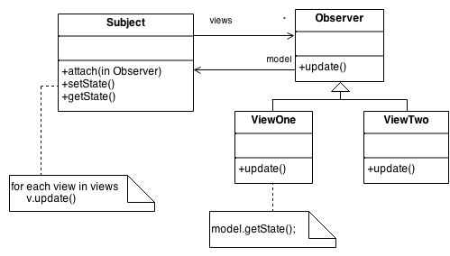
Observer Pattern

Slide 55
State Pattern
The state pattern allows an object to completely change its behavior depending upon its current internal state
The simplest approach would be to add some boolean flags and apply simple if/else statements within each of our methods
This works in a simple scenario.
However, it might complicate and pollute the code with too many states
The State interface declares particular methods that represent the behaviors of a particular state.
Concrete States implement these behaviors.
By changing a Context's Concrete State, we change its behavior.

Slide 56
State Pattern
Define a "context" class to present a single interface to the outside world.
Define a State abstract base class.
Represent the different "states" of the state machine as derived classes of the State base class.
Define state-specific behavior in the appropriate State derived classes.
Maintain a pointer to the current "state" in the "context" class.
To change the state of the state machine, change the current "state" pointer.

Slide 57
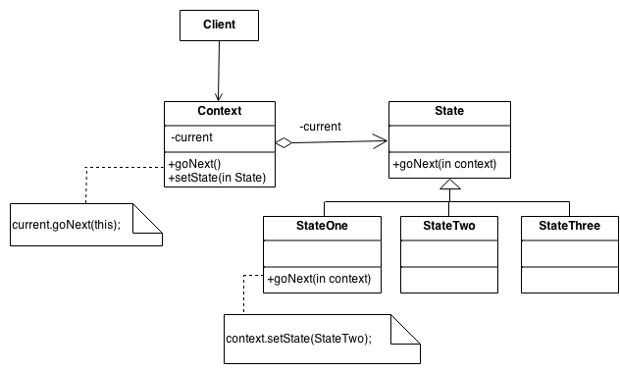
State Pattern

Slide 58
State vs Strategy
Both design patterns are very similar, but with the idea behind them slightly different.
First, the strategy pattern defines a family of interchangeable algorithms. Generally, they achieve the same goal, but with a different implementation, for example, sorting or rendering algorithms.
In state pattern, the behavior might change completely, based on actual state
Next, in strategy, the client has to be aware of the possible strategies to use and change them explicitly
Whereas in state pattern, each state may be linked to another and create the flow as in Finite State Machine

Slide 59
Learn More
Explore links below for other patterns and good examples:
https://www.blackwasp.co.uk/GofPatterns.aspx
https://sourcemaking.com/design_patterns
https://www.avajava.com/tutorials/categories/design-patterns

